Slide 1

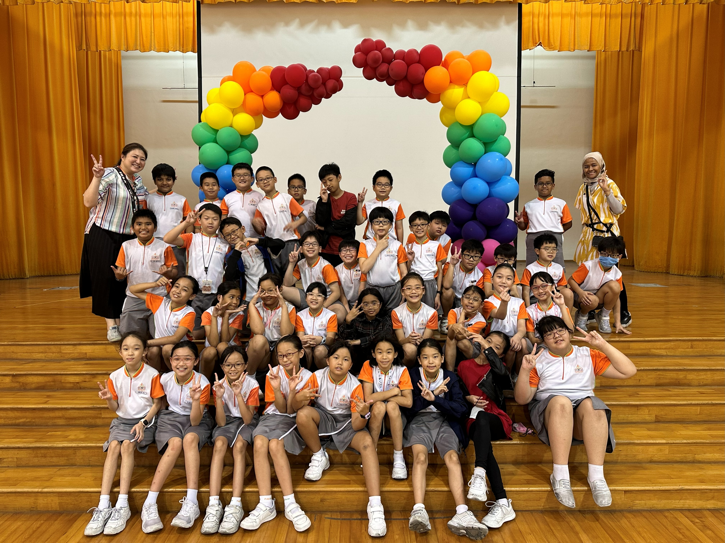
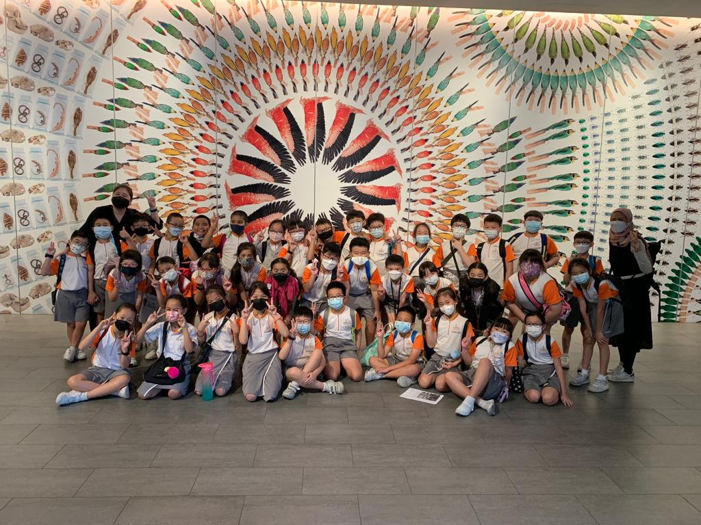
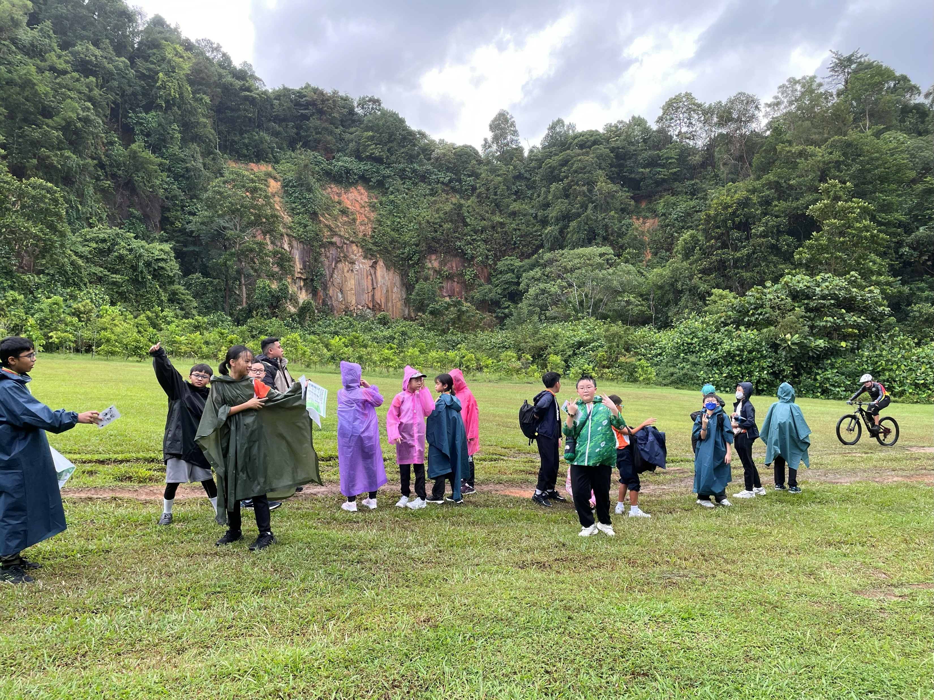
Credits:
Main Producers:
Khoi Nguyen
Divyansh Joshi
Giselle Quek
Fan Xulin
Guo Xiangle
Featured In Video:
All fellow P6 students
Special Thanks To::
Mdm Kalpana
Mdm Zhang
Mrs Chen
Mr Zack
Ms Germaine
Mr Rafiei
Mrs Serene Yue
Mr Gerald Wong
Mr Hisham
Mrs Sarah Tan
Ms Nicole Chee
Mdm Hasanah
Thanks for watching!

